Slide 1
IT 122: DATABASE SYSTEMS DESIGN I
Instructor: Edison Nkurunungi
Tel: +256 772 955 373/ 702 955372
Email: edison.nkurunungi@uict.ac.ug

Slide 2
Introduction
A database is an organized set of data items that reduces duplication of the stored records. It is a collection of related records which can be used to produce information. Databases exist to serve the needs of applications. An application, in turn, is a unit of software that exists to serve the needs of some activity (user).
The basic idea of a database is to store data in an organized way.

Slide 3
Definition of (Database) Application Program
A computer program that interacts with the database by issuing an appropriate request (typically an SQL statement) to the DBMS
Users interact with the database through a number of application programs (used to create & maintain the database & to generate information) written in some programming language

Slide 4
Traditional File Systems
In computing, a file-system is a method for storing and organizing computer files and the data they contain to make it easy to find and access them.
File-systems were an early attempt to computerize the manual filing system; the normal filing system works well while the data items to be stored are few. However, it becomes impossible to use when we have to cross-reference or process data jointly from different files.

Slide 5
Traditional file systems…
It is also called a traditional based approach in which a decentralized approach was taken where each department stored and controlled its own data with the help of a data processing specialist.
The main role of a data processing specialist was to create the necessary computer file structures, and also manage the data within structures and design some application programs that create reports based on file data.

Slide 6
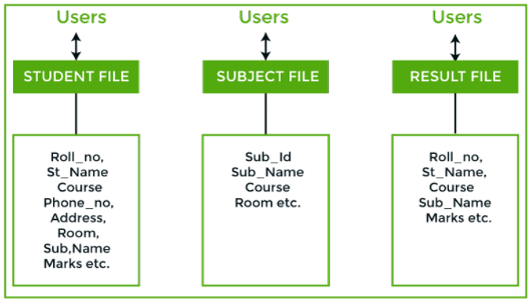
Illustration of Traditional File System

Slide 7
Traditional file systems…
Consider an example of a student's file system on the previous slide. The student file will contain information regarding the student (i.e. roll no, student name, course etc.). Similarly, we have a subject file that contains information about the subject and the result file which contains the information regarding the result.
Some fields are duplicated in more than one file, which leads to data redundancy. So to overcome this problem, we need to create a centralized system, i.e. DBMS approach.

Slide 8
Characteristics of File Processing Systems
It is a group of files storing data of an organization. • Each file is independent from one another. • Each file is called a flat file. • Each file contained and processed information for one specific function, such as accounting or inventory. • Files are designed by using programs written in programming languages such as COBOL, C, C++.

Slide 9
Limitations / Problems with using File Systems
1. Separation and isolation of data -Difficult to access data that is available (eg. from two files. Student that achieved good academic result and active in extra curriculum activities)
2. Duplication of data -Cost time and money to enter data more than once -Additional storage space is needed - cost -Inconsistencies of data
3. Data dependence -File structure is defined in the application program code. -Changes to an existing structure are difficult to make

Slide 10
Limitations / Problems with using File Systems cont’d
4. Incompatible file formats
- As the structure of files is embedded in the application programs, the structures are dependent on the application programming language. For example, the structure of a file generated by a COBOL program may be different from the structure of a file generated by a ‘C’ program. The direct incompatibility of such files makes them difficult to process jointly.
5. Poor data modeling of real world situations
- The file based system is not able to represent the complex data and interfile relationships, which results poor data modeling properties.

Slide 11
Database Approach to Data Storage
All the above limitations of the file-based approach can be attributed to two factors;
The definition of data is embedded in the application program rather than being stored separately and independently.
There is no control over the access and manipulation of data beyond that imposed by the application program.

Slide 12
Database Approach
Therefore, to become more efficient in data storage and information management, a new approach was required. What emerged were the Database and the Database Management System (DBMS).

Slide 13
What is a Database?
A database is a well-organized collection of data that are related in a meaningful way which can be accessed by different users but stored only once in a system.
The various operations performed by the DBMS system are: Insertion, deletion, selection, sorting etc.

Slide 14
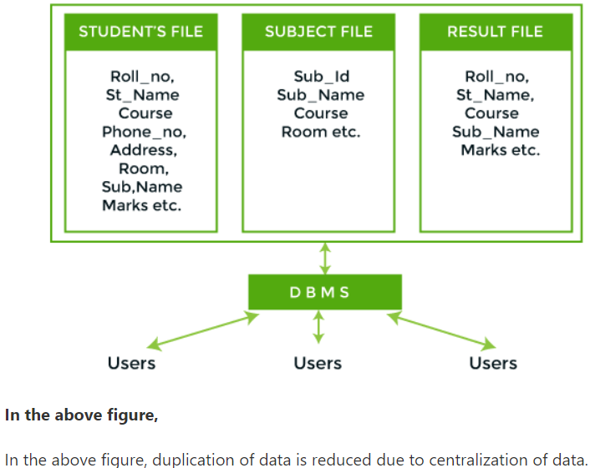
Illustration of DBMS approach

Slide 15
Differences between DBMS and File systems
Parameter | DBMS | File System
Meaning | DBMS is a collection of data. In DBMS, the user is not required to write the procedures. | The file system is a collection of data. In this system, the user has to write the procedures for managing the database.
Sharing of data | Due to the centralized approach, data sharing is easy. | Data is distributed in many files, and it may be of different formats, so it isn't easy to share data.
Data Abstraction | DBMS gives an abstract view of data that hides the details. | The file system provides the detail of the data representation and storage of data.

Slide 16
Differences between DBMS and File systems
Parameter | DBMS | File System
Security and Protection | DBMS provides a good protection mechanism. | It isn't easy to protect a file under the file system.
Recovery Mechanism | DBMS provides a crash recovery mechanism, i.e., DBMS protects the user from system failure. | The file system doesn't have a crash mechanism, i.e., if the system crashes while entering some data, then the content of the file will be lost.
Manipulation Techniques | DBMS contains a wide variety of sophisticated techniques to store and retrieve the data. | The file system can't efficiently store and retrieve the data.

Slide 17
Differences between DBMS and File systems
Parameter | DBMS | File System
Concurrency Problems | DBMS takes care of Concurrent access of data using some form of locking. | No support for concurrent access
Where to use | Database approach used in large systems which interrelate many files. | File system approach used in smaller systems with decentralized files.
Cost | The database system is expensive to design. | The file system approach is cheaper to design.

Slide 18
Differences between DBMS and File systems
Parameter | DBMS | File System
Data Redundancy and Inconsistency | Due to the centralization of the database, the problems of data redundancy and inconsistency are controlled. | Files and application programs are created by different programmers so that there exists a lot of duplication of data which may lead to inconsistency.
Structure | The database structure is complex to design. | The file system approach has a simple structure.
Integrity Constraints | Integrity Constraints are easy to apply. | Integrity Constraints are difficult to implement in file system.

Slide 19
Differences between DBMS and File systems
Parameter | DBMS | File System
Data Models | 3 types of data models exist: Hierarchal data models Network data models Relational data models | In the file system approach, no concept of data models exists.
Data Independence | Data Independence exists, and it can be of two types. Logical Data Independence Physical Data Independence | Data files are embedded in the application programs

Slide 20
Differences between DBMS and File systems
Parameter | DBMS | File System
Flexibility | Changes are often a necessity to the content of the data stored in any system, and these changes are more easily with a database approach. | The flexibility of the system is less as compared to the DBMS approach.
Examples | MySQL, PostgreSQL, Microsoft Access, SQL Server, FileMaker, Oracle, RDBMS, dBASE, Clipper, and FoxPro

Slide 21
Simple database examples
Text File
Imagine we have a text file called "Individual.txt", and that the contents look like this:

Slide 22
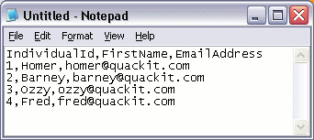
Individual.txt TEXT FILE

Slide 23
Simple database examples….
We could use this information to do things such as send an email to everyone on our list.
We could do this because, due to the way we designed the list, we know that each row contains a different individual, and the information on that row is related to that individual.
Also, the items in each row are separated by commas.

Slide 24
Simple database examples….
Therefore, we know that the email address next to "Homer" is his email address. We could also call each row a record. Therefore, we currently have 4 records in our database.
With a small list like this, a text file may serve our purposes perfectly.

Slide 25
Spreadsheet
Another option would be to store it in a spreadsheet using spreadsheet software (for example, Microsoft Excel). That way, we could do some extra things with our list (such as format it, or sort by first name/surname etc).
A spreadsheet program like Excel makes these tasks relatively easy to do. Also, programs like Excel organize the data into rows and columns, making your data easier to understand. Something like in the next slide:

Slide 26
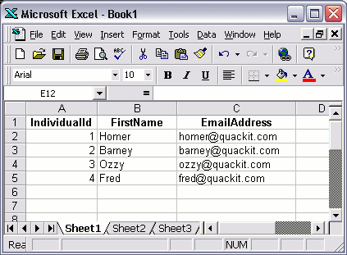
Ms Excel file

Slide 27
Database Software
A better option would be to store the data in a database table using specialized database software, such as Microsoft Access. Something like on the next slide:

Slide 28
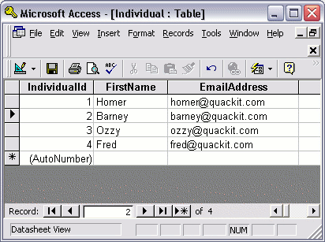
Microsoft Access table

Slide 29
So What's the Difference?
You may be wondering what the difference is between the last two examples (Excel vs Access). After all, both examples have the data organized into rows and columns.
There are many differences between spreadsheet software and database software. The rest of our lessons will show why database software is a much better option for creating databases

Slide 30
Definitions:
Data means known facts that can be recorded and have implicit (hidden) meaning. E.g. names, telephone numbers, and addresses of the people that you know, are examples of data. Collecting and recording this data in an organized way constitutes into a database. Thus a phone book is an example of a database.

Slide 31
Definitions cont’d
A database is a collection of interrelated data items (and the description of this data) designed and stored to meet information needs of an organization.
These data items are always stored in form of tables. The primary aim of database is to provide a way to store and retrieve database information in a fast and efficient manner.

Slide 32
Database Systems Vs File Systems
There are a number of characteristics that databases differ from traditional file management system. In file system approach, each user defines and implements the needed files for a specific application. For example in an institution like UICT, the office of the academic registrar will maintain records of how many registered students have joined the institution. These details will be stored and maintained in a separate file.

Slide 33
Database Systems Vs File Systems
Another user in the bursar’s office will be maintaining tuition details of all students. The detailed tuition report will be stored and maintained in a separate file. Although both of the users are interested in the data items of the same students, they will be having their details in separate files and they need different programs to manipulate their files. This will lead to the following:

Slide 34
Database Systems Vs File Systems
wastage of storage space
redundancy or replication of data items, which may lead to confusion,
sharing of data among various users is not possible,
also data inconsistency may occur.

Slide 35
Database Systems Vs File Systems
There will not be any inter-relationship among the data’s stored in these files. Therefore in traditional file processing every user will be defining their own constraints/rules and implement the files needed for the applications.

Slide 36
Database Systems Vs File Systems
In database approach, a single repository of data is maintained that is defined once and then accessed by many users.
The fundamental characteristic of database approach is that the database system not only contains data items but it contains complete definition or description of the database structure and constraints/rules.

Slide 37
Database Systems Vs File Systems
The other main characteristic of the database is that it will allow multiple users to access the database at the same time and sharing of data is possible. The database must include concurrency control (mechanism) software to ensure that several users can update the same data at the same time, but this should be maintained in a controlled manner.

Slide 38
Database Systems Vs File Systems
For these reasons, a database is also called a self-describing collection of integrated records.
The description of data is known as the data dictionary (meta data).

Slide 39
Database Systems Vs File Systems
From the database definition, it is logically related. This is because, when we analyze the information needs in an organization, we attempt to identify entities, attributes and relationships.

Slide 40
Data Modeling Definitions
An entity is a distinct object (e.g. a person, a place etc) in the organization that is to be represented in the database.
An Attribute is a property that describes some aspect of the object that we wish to record (e.g. name, height, and sex of a person) and

Slide 41
Data Modeling Definitions (cont’d)
A relationship is an association between several entities.
The database represents the entities, the attributes and the logical relationships between the entities. Thus, data in the database is logically related.

Slide 42
Entities and their attributes
Taking UICT as our case study, we can create a database by identifying the following
Entity1: student
Attributes: regNo, student_name, age, homeaddress, etc
Entity2: lecturer
Attributes: lecturer IDNo, name, age, status, etc

Slide 43
Entities and their attributes….
Entity3: course
Attributes: course ID, course Name, lectureIDNo
Entiti4: lecture_room
Attributes: room No, room Name, location
Relation Ship1: course lectured by lecturer
Relation Ship2: course taken by student

Slide 44
Note:
The total numbers of entities and relationships depend on the nature of the organization and the required data to be stored.

Slide 45
In summary, Databases are important because….
They can store a large number of records,
There is ease of use when accessing information,
It is easy to add new data and to edit or delete old data,
There is ease of storage,
Data can be imported into other applications,
More than one person can access the same database at the same time, and
Data security is enhanced as access to some of the information is restricted.

Slide 46
Components of a Database
A database comprises of various components/objects that include the following;
1-Tables:- A table is a primary object of the database. Tables are used to collect and store data relating to a particular subject. Tables are organized in rows and columns as shown in the figure below:

Slide 47
Table Name: Registration (an example of a table structure)
studentNo | fName | lName | age | sex
2006/REC/026 | Mukasa | John | 32 | M
2006/ITB/013 | Namukasa | Mary | 28 | F

Slide 48
Table description
Each column is called a Field or an attribute and it contains the same type of information for every entity occurrence.
Each row is called a record or a tuple and it contains all the information about one entity occurrence.

Slide 49
2- Forms: -
A form allows a user to view one record at a time on the screen.
It is also commonly used to send information into a table.
Normally, each table has a corresponding form for entering data in it. Figure on the next slide shows a form for entering data in the above table.

Slide 50
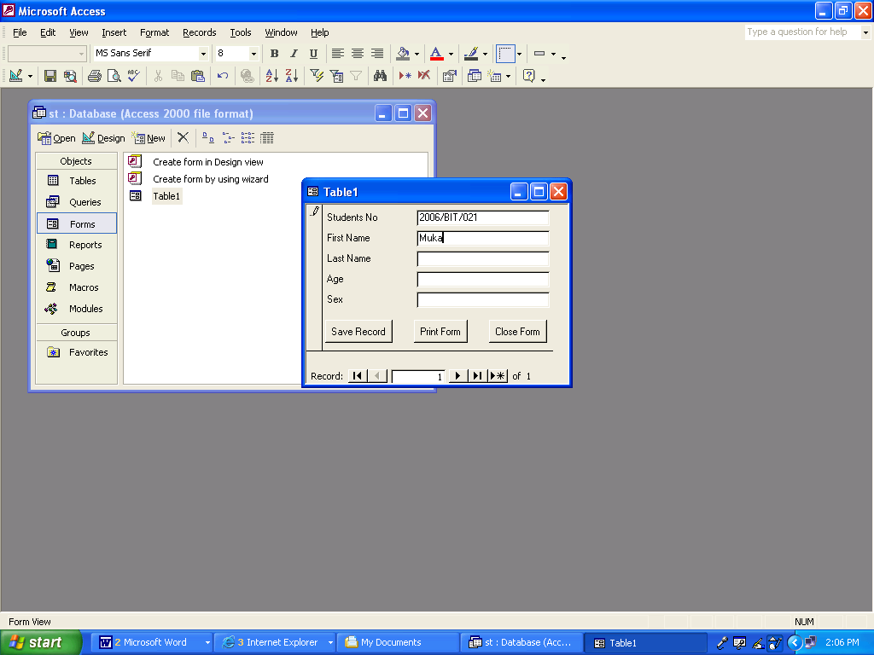
A Form for entering or viewing data in a table

Slide 51
3. Queries: -
A query is a question you ask the database. In a database that stores student’s data, you might query/ask the database for a list of all students who are over the age of 30. The answer usually is a list of records matching the query condition(s).
Data can also be drawn from more than one table and displayed in a single query that can later be used to produce reports.

Slide 52
4. Reports: -
They are used to present, summarize and print table data. Using reports, we can calculate totals and subtotals across a set of records.
Reports can be printed out to present data and information on a hard copy.

Slide 53
Advantages of using databases
Removes duplication of records
Ensures integrity of data, that is, validity and consistency of data. This is achieved by implementing rules that the database is not permitted to violet
Creates uniformity of records
Ensures security of data by restricting unauthorized access

Slide 54
Advantages of using databases cont’d.
Convenience in retrieval and analysis of data
Availability of up-to-date information
Allows multiple usage
Improved backup and recovery services

Slide 55
Disadvantages of using databases
In spite of these advantages, there are some situations where using a DBMS may incur unnecessary overhead costs as compared to traditional file processing. They include;
High initial investment in hardware, software and training.
Not fully reliable e.g. in a networked environment, the entire organization comes to a stand still if the server crashes.

Slide 56
Disadvantages of using databases cont’d.
Requires a lot of time to design. This is because the functionality we expect of a good database makes the DBMS an extremely complex piece of software to design.
Performance: typically, a file-based system is written for a specific application, such as invoicing, payroll, etc. As a result, performance is generally very good.
However, the DBMS is written to be more general to cater for many applications rather than just one. The result is that some applications may not run as fast as before.

Slide 57
The Database Management System (DBMS)
A Database Management System (DBMS), is a software program that enables the creation and management of databases. Generally, these databases will be more complex than the text file/spreadsheet examples seen in the previous slides.
In fact, most of today's database systems are referred to as a Relational Database Management System (RDBMS), because of their ability to store related data across multiple tables.

Slide 58
Examples of Relational database management systems
Some of the more popular relational database management systems include:
Microsoft Access
MySQL
Oracle
Ms Sql Server
PostgreSql
IBM DB2

Slide 59
Functions of a DBMS
A DBMS interacts with user’s application programs and the database. Typically, a DBMS provides the following facilities
It allows users to create/define a database, usually using a data definition language (DDL)
It allows users to insert, update, and delete data from the database using a data manipulation language (DML)

Slide 60
Functions of a DBMS cont’d.
It provides controlled access to the database e.g. it may provide;
- a security system, which prevents unauthorized users from accessing the database
- an integrity system, which maintains the consistency of stored data (entity integrity, referential integrity, and domain integrity)
- a concurrency control system, which allows shared access to the database
- a user-accessible catalog/register, which contains description of data in the database

Slide 61
Components of a DBMS environment
Components of a DBMS are identified as;
Hardware,
Software,
Data,
Procedures, and
People.

Slide 62
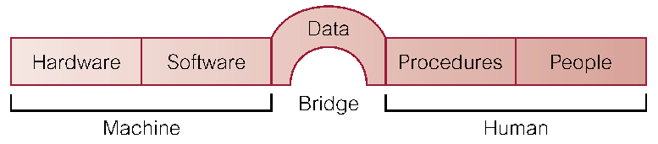
ILLUSTRATION OF THE COMPONENTS OF A DBMS ENVIRONMENT

Slide 63
Components of a DBMS
Hardware: The database requires computer hardware to run. The hardware can range from a single Personal Computer to a network of computers. The hardware depends on the organization’s information requirements and the DBMS used.
Software: The software component comprises of the DBMS itself, together with the operating system, including network software if the DBMS is to be used on a network.
Data: From the end user’s point of view, data is the most important component of a DBMS environment. This includes both operational data and meta data.

Slide 64
Components of a DBMS
Procedures: These are instructions and rules that govern the design and use of the database. Database users require documented procedures on how to use and run the database system. Such procedures may consist of instructions on how to:
- log on the DBMS
- start/stop the DBMS
- make backup copies of the database etc

Slide 65
Components of a DBMS
People: These are users of the database and they are in the following three categories
Programmers; responsible for developing the database and writing the application programs that use the database
End Users; these access and alter data from database terminals
Database administrators; responsible for real control of the database

Slide 66
Components (cont’d)
Users of the database communicate their requirements to the database using Data Definition Language (DDL) and Data Manipulation Languages (DML).
Generally, the DBMS provides an interface between the user’s programs and the contents of the database.

Slide 67
DBMS Interfaces
When you are using a basic command-line DBMS such as Oracle, and MySql, external development are required to build application programs which can be used to access the database. E.g. u can use Visual Basic to create the application, and use the database for storage.
However, there are graphical DBMS such as Access which has a built-in application for building its own interfaces.

Slide 68
DBMS ARCHITECTURE/DESIGN
A DBMS is divided into 3 levels, usually referred to as:
external level,
internal level and
the conceptual level.

Slide 69
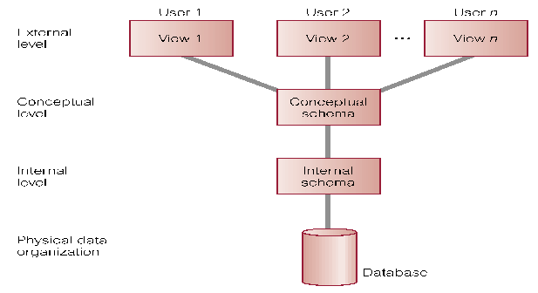
ILLUSTRATION OF THE ANSI-SPAC THREE-LEVEL ARCHITECTURE
The way the users perceive the data.
Mapping and independence between external and internal levels.
The way the DBMS and OS perceive the data.
Main Objective: separate each user’s view of the database from the way it is physically represented.

Slide 70
The external level
This is the level closest to the users. It is the one concerned with the way data is seen by individual users.
The end user is presented with special views that are tailored to their specific needs. Some of these views may be forms to fill out, others for interactive retrieval of information, etc.

Slide 71
External level….
Provides a powerful and flexible security mechanism by hiding parts of the DB from certain users. The user is not aware of the existence of any attributes that are missing from the view.
It permits users to access data in a way that is customized to their needs, so that the same data can be seen by different users in different ways, at the same time.

Slide 72
The internal level
This is the closest to the physical storage. That is to say, it is the one concerned with the way data is stored inside the system (Physical representation of the DB on the computer-storage medium)
Physical implementation of the DB to achieve optimal run– time performance and storage space utilization.
Storage space allocation for data and indexes
Record description for storage
Record placement
Data compression, encryption

Slide 73
The conceptual level
This is the level between the other two levels
Description of the structure of the entire DB. Hides the details of physical storage. Concentrates on describing entities, data types, relationships, user operations, and constraints. In the relational model, this is the base tables.
Changes at this level can be made without having any effect on the external level

Slide 74
Specific objectives of three-level architecture
All users should be able to access same data.
A user's view is immune to changes made in other views.
Users should not need to know physical database storage details.
DBA should be able to change database storage structures without affecting the users' views.
Internal structure of database should be unaffected by changes to physical aspects of storage. (e.g. change-over to a new storage device- HD)
DBA should be able to change conceptual structure of database without affecting all users.

Slide 75
A Data Dictionary
This is an index of data held in the database. It is used to assist in maintenance and any other access of the database.
It provides a method for looking up data items stored in the database. The data dictionary contains the following:

Slide 76
A Data Dictionary
Field names, field types, lengths and the default values. Example; a year field would be numerical, with four digits and may have a default value of the current year.
Note that if these aspects are defined in a data dictionary, they only need to be defined once no matter how often they are applied by other programs using the database.

Slide 77
A Data Dictionary
It also shows a list of all entities, attributes and relationships in the database.
The meaning of codes and symbols used in the programs.
The origin of data and its ownership

Slide 78
Data and data models
A Data model is an integrated collection of concepts or principles for describing data, relationships between data and constraints on the data in an organization.
It provides basic notations and concepts that will allow database designers and end-users to unambiguously and accurately communicate their understanding of the organisational data.

Slide 79
Data Models
Data models define how the logical structure of a database is modeled. Data Models are fundamental entities to introduce abstraction in a DBMS. Data models define how data is connected to each other and how they are processed and stored inside the system.
The very first data model could be flat data-models, where all the data used are to be kept in the same plane. Earlier data models were not so scientific, hence they were prone to introduce lots of duplication and update anomalies.

Slide 80
Data and data models
Data models are often used as an aid to communication between the business people defining the requirements for a computer system and the technical people defining the design in response to those requirements.

Slide 81
Entity-Relationship Model
Entity-Relationship (ER) Model is based on the notion of real-world entities and relationships among them. While formulating real-world scenario into the database model, the ER Model creates entity sets, relationship sets, general attributes, and constraints. ER Model is best used for the conceptual design of a database.
ER Model is based on:
Entities and their attributes.
Relationships among entities.

Slide 82
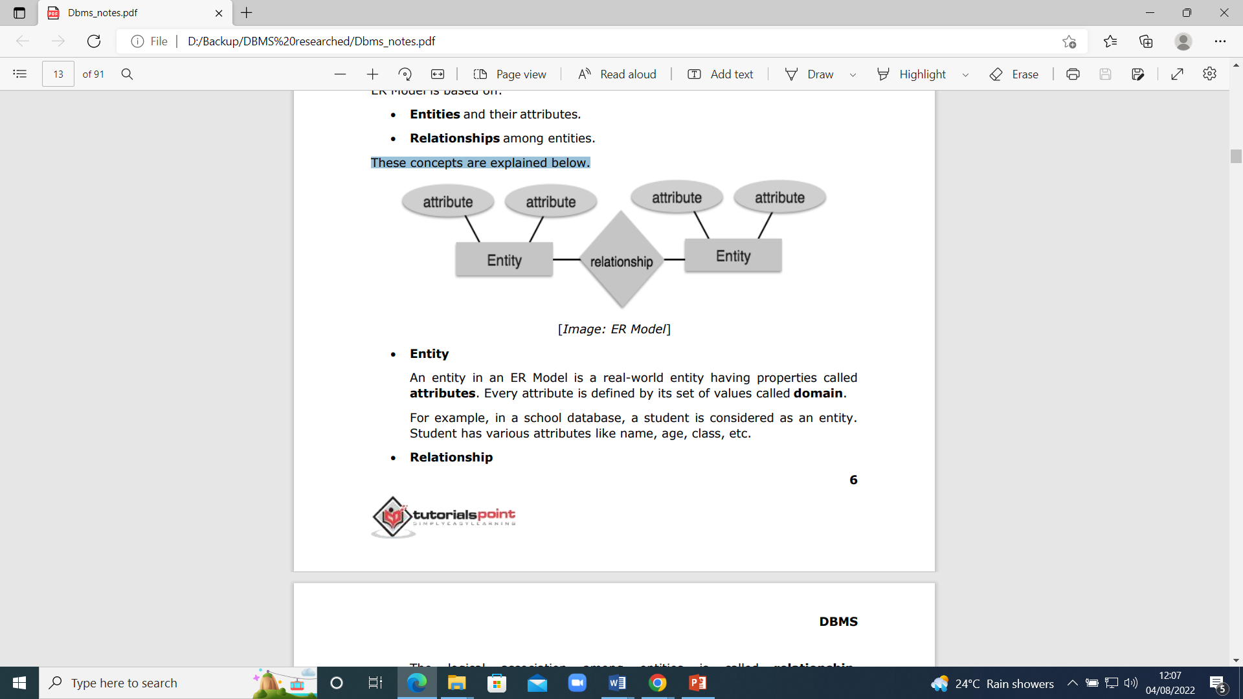
These concepts are explained below.

Slide 83
These concepts are explained below.
Entity: An entity in an ER Model is a real-world object having properties called attributes. Every attribute is defined by its set of values called domain. For example, in a school database, a student is considered as an entity. Student has various attributes like name, age, class, etc.
Relationship: The logical association among entities is called relationship. Relationships are mapped with entities in various ways. Mapping cardinalities define the number of associations between two entities.

Slide 84
Mapping Cardinalities
one to one
A one-to-one relationship exists when each row in one table has only one related row in a second table. For example, a business might decide to assign one office to exactly one employee. Thus, one employee can have only one office. The same business might also decide that a department can have only one manager.
many to many

Slide 85
Mapping Cardinalities
one to many
People-Addresses (Each person can live at one address, but each address can house one or more people.) Owners-Pets (Each pet has one owner, but each owner can have one or more pets.)
many to one
Refer to the above example
many to many
Customer can purchase various products, and a product can be purchased by many customers

Slide 86
Relational Model
The most popular data model in DBMS is the Relational Model. It is more scientific a model than others.
The main highlights of this model are:
Data is stored in tables called relations.
Relations can be normalized.
In normalized relations, values saved are atomic values.
Each row in a relation contains a unique value.
Each column in a relation contains values from a same domain.

Slide 87
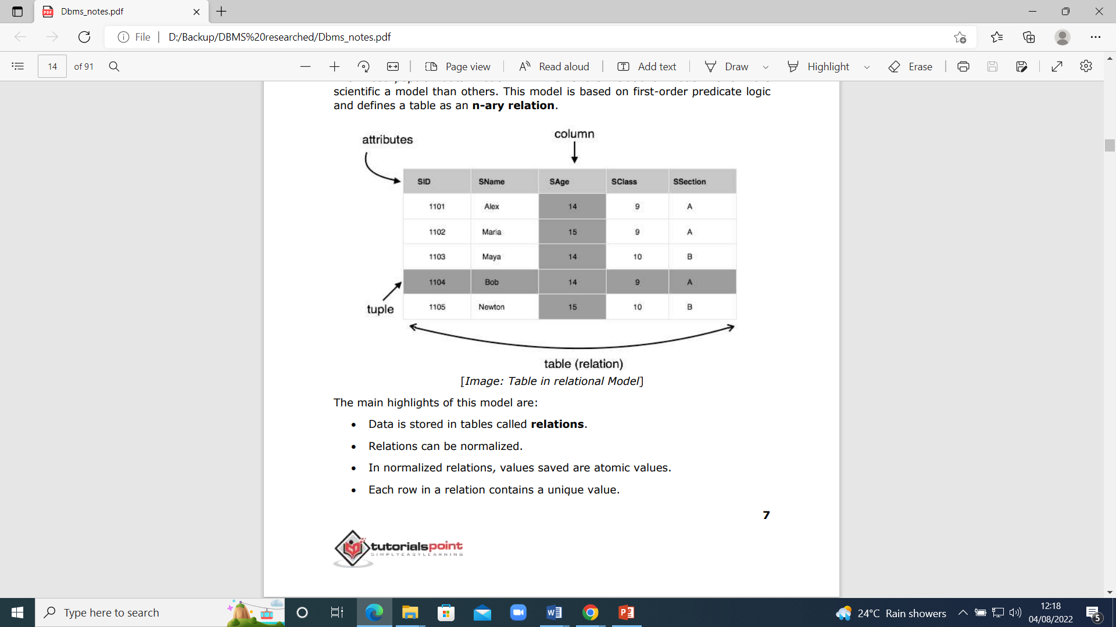
A Relation

Slide 88
Assignment
Read and make notes about
Hierarchical data model
Network data model

Slide 89
Data Independence
If a database system is not multi-layered, then it becomes difficult to make any changes in the database system. Database systems are designed in multi-layers as we learnt earlier.
A database system normally contains a lot of data in addition to users’ data. For example, it stores data about data, known as metadata, to locate and retrieve data easily.
It is rather difficult to modify or update a set of metadata once it is stored in the database. But as a DBMS expands, it needs to change over time to satisfy the requirements of the users. If the entire data is dependent, it would become a tedious and highly complex job.

Slide 90
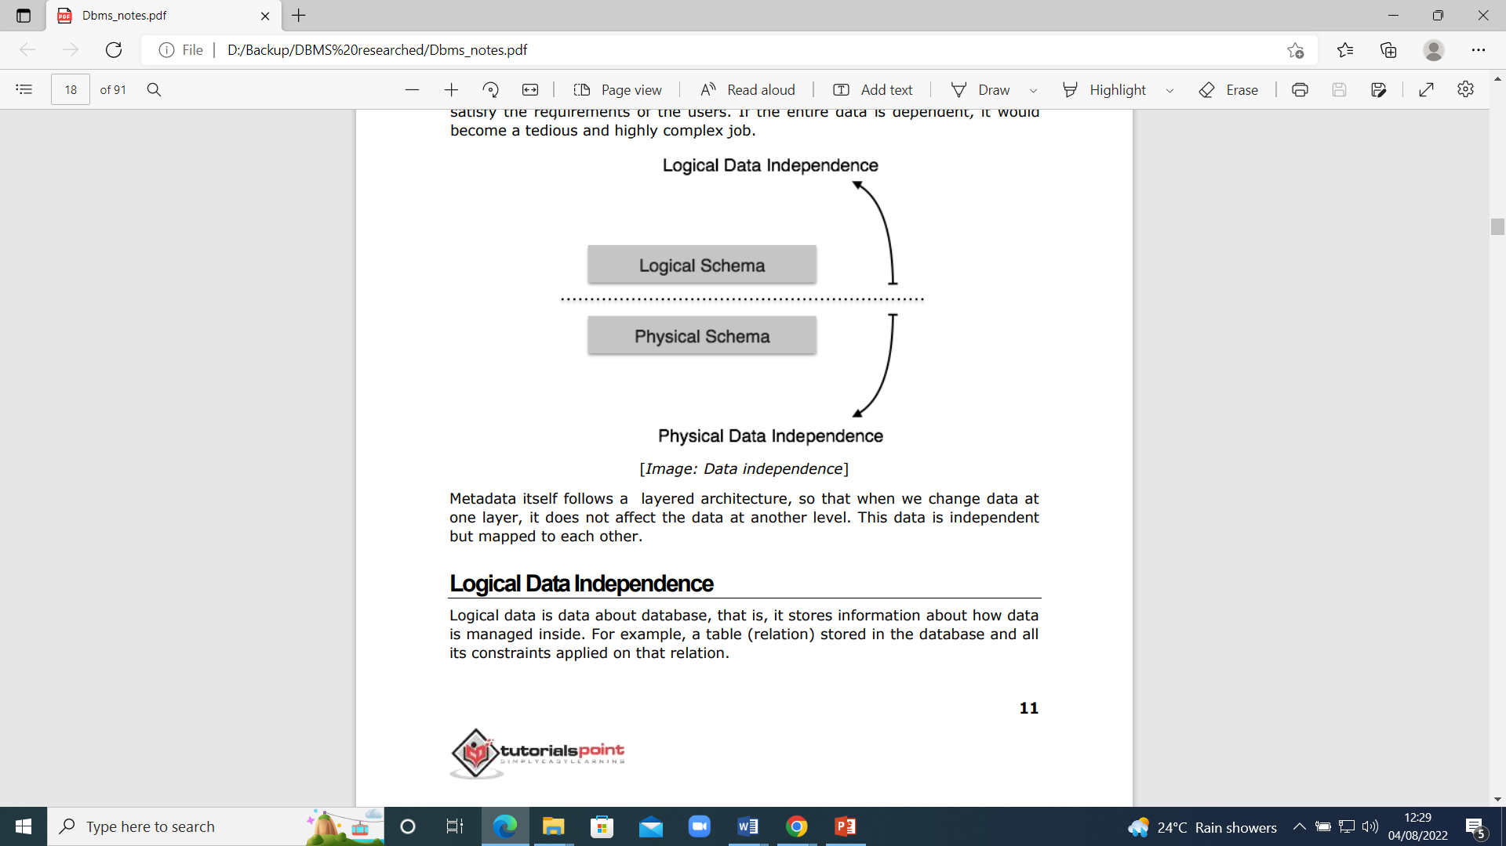
Data Independence

Slide 91
Data Independence…
Metadata itself follows a layered architecture, so that when we change data at one layer, it does not affect the data at another level. This data is independent but mapped to each other.

Slide 92
Logical Data Independence
Logical data is data about database, that is, it stores information about how data is managed inside. For example, a table (relation) stored in the database and all its constraints applied on that relation.
Logical data independence is a kind of mechanism, which liberalizes itself from actual data stored on the disk. If we do some changes on table format, it should not change the data residing on the disk.

Slide 93
Physical Data Independence
All the schemas are logical, and the actual data is stored in bit format on the disk. Physical data independence is the power to change the physical data without impacting the schema or logical data. For example, in case we want to change or upgrade the storage system itself — suppose we want to replace hard-disks with SSD — it should not have any impact on the logical data or schemas

Slide 94
Levels of data modeling
Data models are divided into three levels
1- conceptual model
2- logical model
3- physical model

Slide 95
Comparison between the three ways of data modeling
Feature | Conceptual | Logical | Physical
Entity Names | ✓ | ✓
Entity Relationships | ✓ | ✓
Attributes |  | ✓
Primary Keys |  | ✓ | ✓
Foreign Keys |  | ✓ | ✓
Table Names |  |  | ✓
Column Names |  |  | ✓
Column Data Types |  |  | ✓

Slide 96
Levels of data modeling…
The conceptual model
A conceptual data model identifies the highest-level relationships between the different entities. Features of conceptual data model include:
The important entities and the relationships among them.
No attribute is specified.
No primary key is specified.

Slide 97
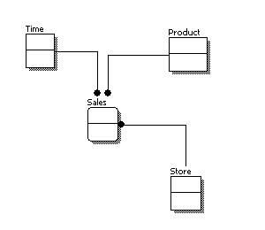
The figure below is an example of a conceptual data model.

Slide 98
The Logical Model
A logical data model describes the data in as much detail as possible, without regard to how they will be physically implemented in the database. Features of a logical data model include:
All entities and relationships among them.
All attributes for each entity are specified.
The primary key for each entity is specified.
Foreign keys (keys identifying the relationship between different entities) are specified.

Slide 99
The steps for designing the logical data model are as follows:
Specify primary keys for all entities.
Find the relationships between different entities.
Find all attributes for each entity.
Resolve many-to-many relationships.
Normalization.

Slide 100
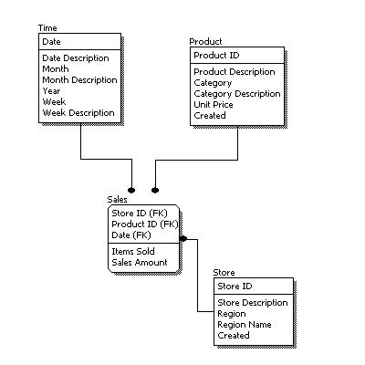
The figure below is an example of a logical data model.

Slide 101
Logical data model Vs conceptual data model diagrams
In a logical data model, primary keys are present, whereas in a conceptual data model, no primary key is present.
In a logical data model, all attributes are specified within an entity. No attributes are specified in a conceptual data model.
Relationships between entities are specified using primary keys and foreign keys in a logical data model. In a conceptual data model, the relationships are simply stated, not specified, so we simply know that two entities are related, but we do not specify what attributes are used for this relationship.

Slide 102
The physical model
Physical data model represents how the model will be built in the database.
A physical database model shows all table structures, including column names, column data types, column constraints, primary keys, foreign keys, and relationships between tables.

Slide 103
Features of a physical data model include:
Specification of all tables and columns.
Foreign keys are used to identify relationships between tables.
Denormalization may occur based on user requirements.
Physical considerations may cause the physical data model to be quite different from the logical data model.
Physical data model will be different for different RDBMS. For example, data type for a column may be different between MySQL and SQL Server.

Slide 104
The steps for physical data model design are as follows:
Convert entities into tables.
Convert relationships into foreign keys.
Convert attributes into columns.
Modify the physical data model based on physical constraints / requirements.

Slide 105
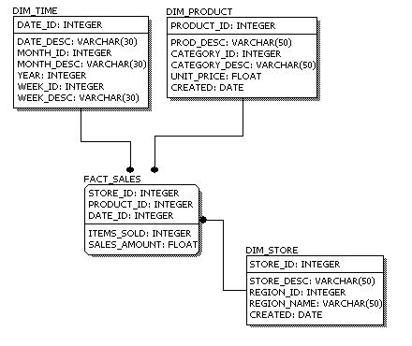
The figure below is an example of a physical data model.

Slide 106
END

Slide 107
***END***
Thanks for your audience !!!

